Slide 1
HAND ASSIST ROBOT 로봇공학입문
기계공학전공
2016121150 윤준영

Slide 2
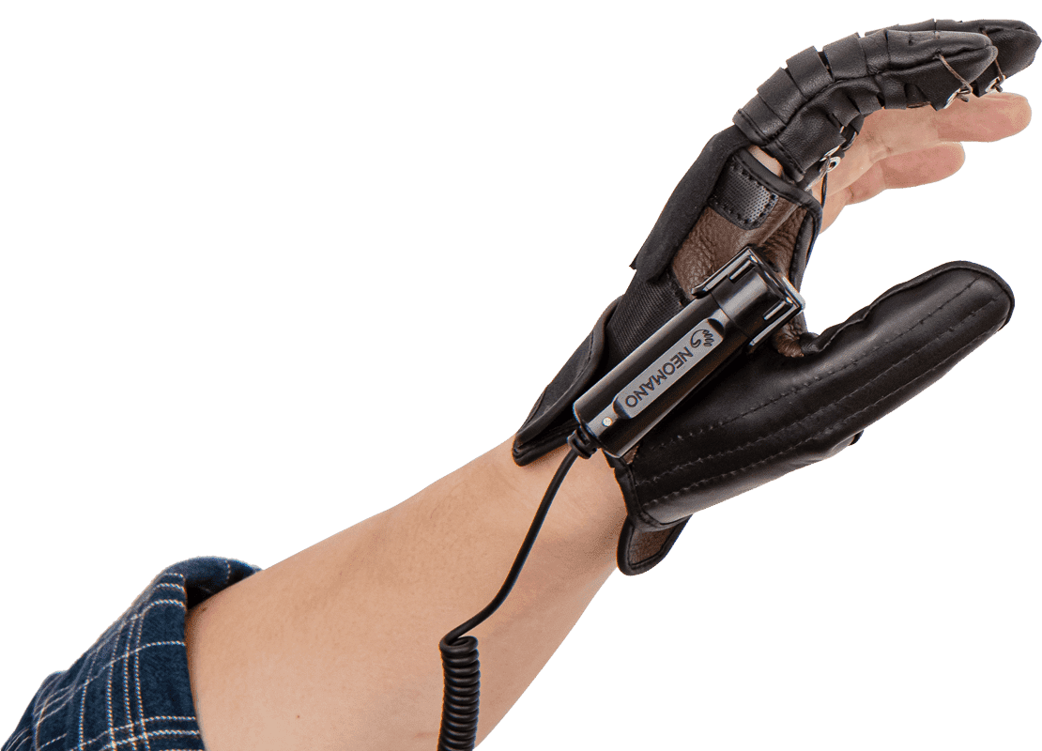
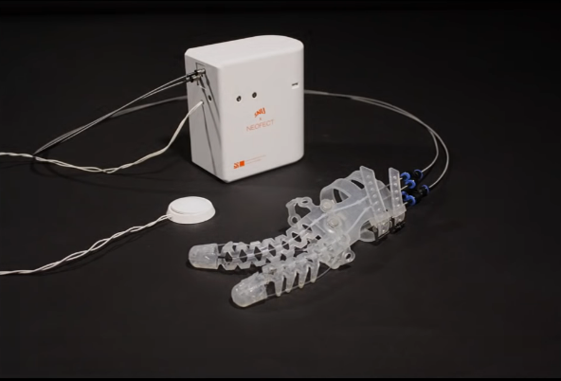
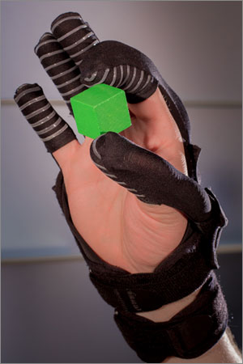
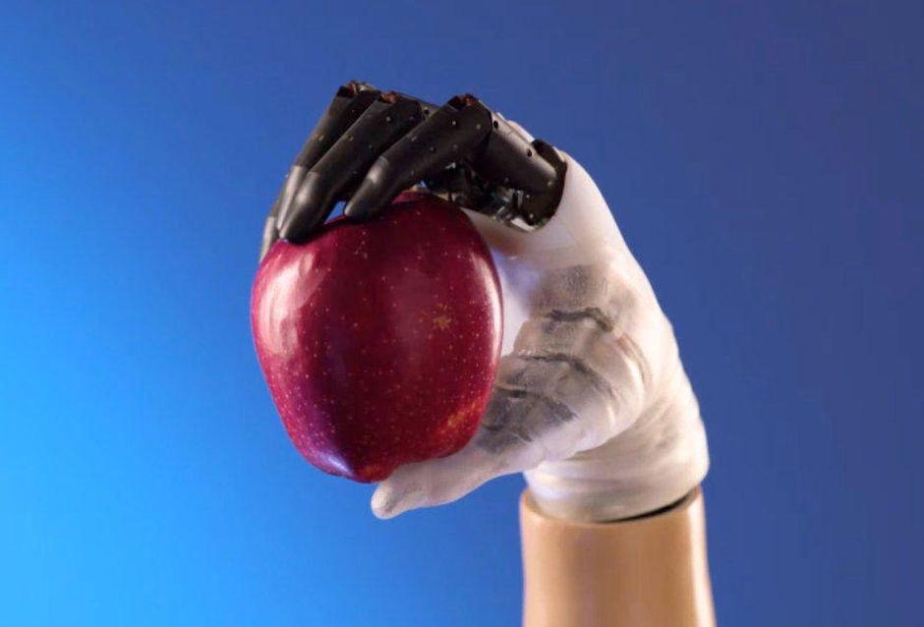
Introduction
Hand-assist robots
Necessity
Limitation
Breakthrough?
source: neofect
source: SNU BioRobotics Lab
source: Rehab Technologies
source: Harvard Wyss Institute

Slide 3
Project Target & Goals
Improve independence
Easy to control
- freely controllable with adaptation
Rehabilitation
- Improve muscle and grabbing power

Slide 4
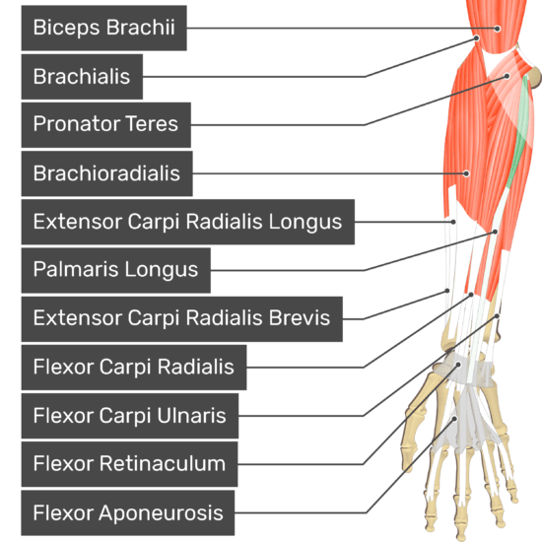
Mechanism
How to?
- electric signal (X)
- perimeter (O)
Hand related arm muscles
- brachioradialis(완요골근) : lifting
- palmaris longus(수장근) : grabbing
source: GetBodySmart

Slide 5
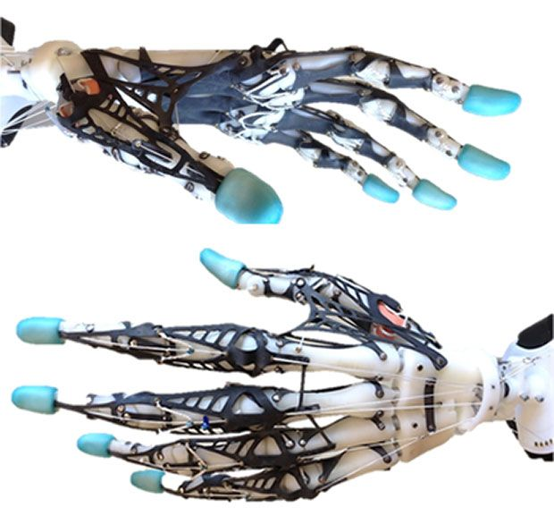
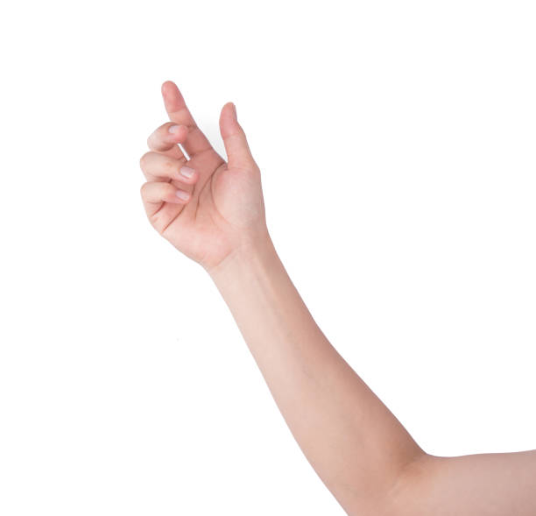
Structure
source: Movement Control Lab., Washington Univ.
DOF (1+3 fingers)
- (1 x 3) + (3 x 3) DOF
Perimeter measurement
- strain gauge
Control
- with wire (PE)
Target grabbing power
- 10 ~ 20N
50mm below elbow | perimeter
with no grasp | 248mm
with grasp | 252mm
motor
controller
wire control |  | wire length
with no grasp |  | 0 (reference)
grasp | index finger | -50mm
 | middle finger | -55mm
Strain-gauge

Slide 6
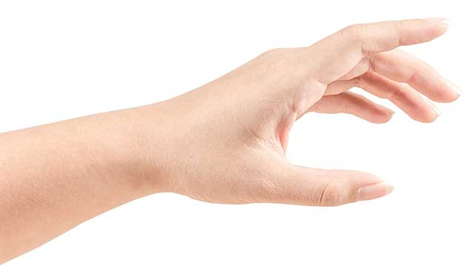
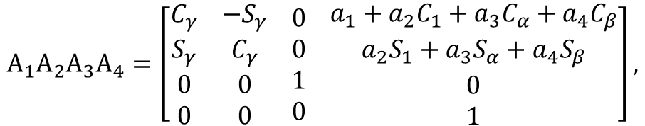
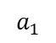
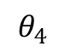
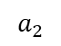
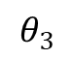
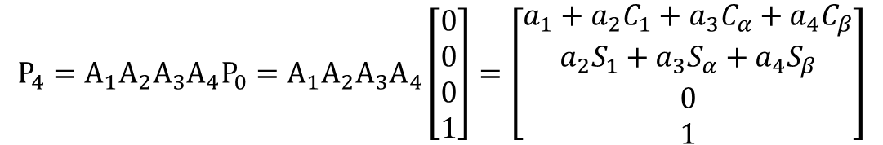
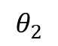
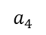
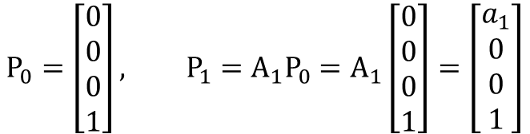
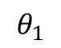
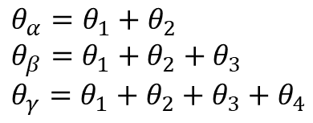
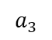
Mechanics
3
T(4)
2
$$a_{4}$$
$$a_{3}$$
1
$$a_{2}$$
$$θ_{4}$$
$$θ_{3}$$
$$a_{1}$$
$$θ_{2}$$
$$A_{1}A_{2}A_{3}A_{4}=\left[\begin{aligned}C_{γ} \\ S_{γ} \\ 0 \\ 0\end{aligned} \begin{aligned}−S_{γ} \\ C_{γ} \\ 0 \\ 0\end{aligned} \begin{aligned}0 \\ 0 \\ 1 \\ 0\end{aligned} \begin{aligned}a_{1}+a_{2}C_{1}+a_{3}C_{α}+a_{4}C_{β} \\ a_{2}S_{1}+a_{3}S_{α}+a_{4}S_{β} \\ 0 \\ 1\end{aligned}\right],$$
$$θ_{α}=θ_{1}+θ_{2} \\ θ_{β}=θ_{1}+θ_{2}+θ_{3} \\ θ_{γ}=θ_{1}+θ_{2}+θ_{3}+θ_{4}$$
$$θ_{1}$$
W(0)
Position of W(0), 1, T(4)
$$P_{0}=\left[\begin{aligned}0 \\ 0 \\ 0 \\ 1\end{aligned}\right], {P_{1}=A}_{1}P_{0}=A_{1}\left[\begin{aligned}0 \\ 0 \\ 0 \\ 1\end{aligned}\right]=\left[\begin{aligned}a_{1} \\ 0 \\ 0 \\ 1\end{aligned}\right]$$
$${P_{4}=A}_{1}A_{2}A_{3}A_{4}P_{0}=A_{1}A_{2}A_{3}A_{4}\left[\begin{aligned}0 \\ 0 \\ 0 \\ 1\end{aligned}\right]=\left[\begin{aligned}a_{1}+a_{2}C_{1}+a_{3}C_{α}+a_{4}C_{β} \\ a_{2}S_{1}+a_{3}S_{α}+a_{4}S_{β} \\ 0 \\ 1\end{aligned}\right]$$

Slide 7
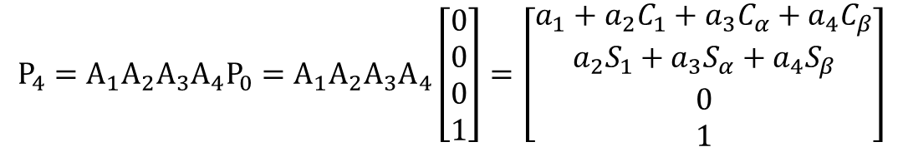
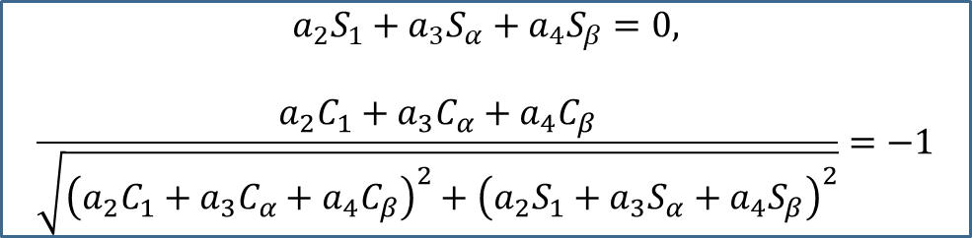
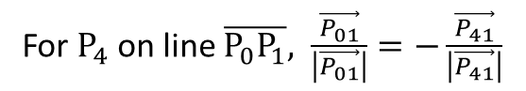
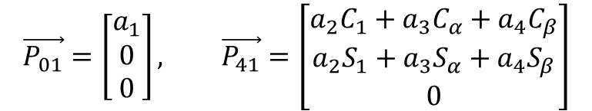
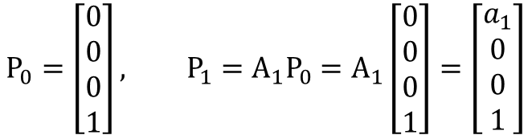
Mechanics
$$P_{0}=\left[\begin{aligned}0 \\ 0 \\ 0 \\ 1\end{aligned}\right], {P_{1}=A}_{1}P_{0}=A_{1}\left[\begin{aligned}0 \\ 0 \\ 0 \\ 1\end{aligned}\right]=\left[\begin{aligned}a_{1} \\ 0 \\ 0 \\ 1\end{aligned}\right]$$
3
T(4)
2
$$a_{4}$$
$$a_{3}$$
1
$$a_{2}$$
$$θ_{4}$$
$$θ_{3}$$
$$a_{1}$$
$$θ_{2}$$
$${P_{4}=A}_{1}A_{2}A_{3}A_{4}P_{0}=A_{1}A_{2}A_{3}A_{4}\left[\begin{aligned}0 \\ 0 \\ 0 \\ 1\end{aligned}\right]=\left[\begin{aligned}a_{1}+a_{2}C_{1}+a_{3}C_{α}+a_{4}C_{β} \\ a_{2}S_{1}+a_{3}S_{α}+a_{4}S_{β} \\ 0 \\ 1\end{aligned}\right]$$
$$θ_{1}$$
W(0)
Vectors, 0→1 & 1→4
$$\vec{P_{01}}=\left[\begin{matrix}a_{1} \\ 0 \\ 0\end{matrix}\right], \vec{P_{41}}=\left[\begin{matrix}a_{2}C_{1}+a_{3}C_{α}+a_{4}C_{β} \\ a_{2}S_{1}+a_{3}S_{α}+a_{4}S_{β} \\ 0\end{matrix}\right]$$
$$a_{2}S_{1}+a_{3}S_{α}+a_{4}S_{β}=0,$$
$$\frac{a_{2}C_{1}+a_{3}C_{α}+a_{4}C_{β}}{\sqrt{{\left(a_{2}C_{1}+a_{3}C_{α}+a_{4}C_{β}\right)}^{2}+{\left(a_{2}S_{1}+a_{3}S_{α}+a_{4}S_{β}\right)}^{2}}}=−1$$
For $P_{4}$ on line $\overline{P_{0}P_{1}}, \frac{\vec{P_{01}}}{\left|\vec{P_{01}}\right|}=−\frac{\vec{P_{41}}}{\left|\vec{P_{41}}\right|}$

Slide 8
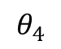
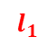
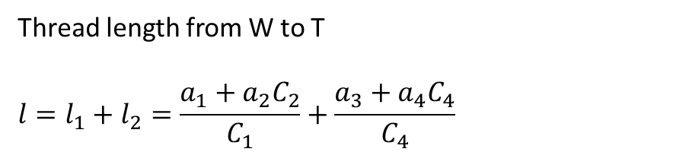
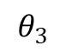
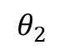
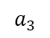
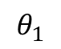
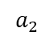
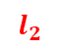
Mechanics
Thread length from W to T
$$l=l_{1}+l_{2}=\frac{a_{1}+a_{2}C_{2}}{C_{1}}+\frac{a_{3}+a_{4}C_{4}}{C_{4}}$$
1
2
$$a_{1}$$
$$a_{2}$$
$$a_{3}$$
W(0)
3
$$l_{1}$$
$$θ_{2}$$
$$θ_{3}$$
$$θ_{1}$$
$$l_{2}$$
$$a_{4}$$
$$θ_{4}$$
T(4)

Slide 9
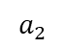
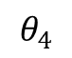
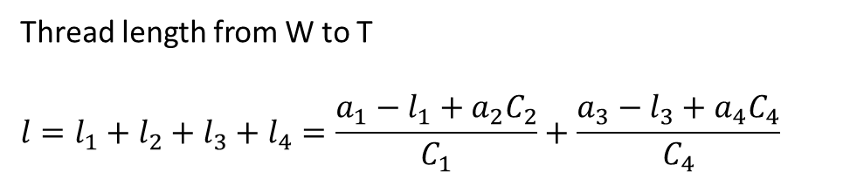
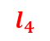
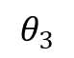
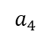
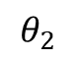
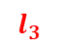
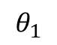
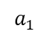
Mechanics – 2
Thread length from W to T
$$l=l_{1}+l_{2}=\frac{a_{1}+a_{2}C_{2}}{C_{1}}+\frac{a_{3}+a_{4}C_{4}}{C_{4}}$$
1
2
$$a_{1}$$
$$a_{2}$$
$$a_{3}$$
W(0)
3
$$l_{1}$$
$$θ_{2}$$
$$θ_{3}$$
$$θ_{1}$$
$$l_{2}$$
$$a_{4}$$
$$θ_{4}$$
T(4)
to remove wire length difference cause by wrist posture
→ make wire start from wrist
Thread length from W to T
$$l=l_{1}+l_{2}+l_{3}+l_{4}=\frac{a_{1}−l_{1}+a_{2}C_{2}}{C_{1}}+\frac{a_{3}−l_{3}+a_{4}C_{4}}{C_{4}}$$
1
2
$$a_{1}$$
$$a_{2}$$
$$a_{3}$$
W(0)
3
$$l_{2}$$
$$l_{1}$$
$$θ_{2}$$
$$θ_{3}$$
$$l_{3}$$
$$θ_{1}$$
$$θ_{4}$$
$$a_{4}$$
$$l_{4}$$
T(4)

Slide 10
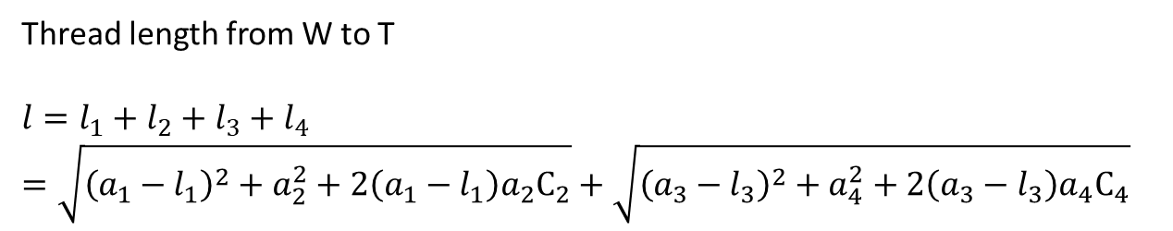
Mechanics – 3
Thread length from W to T
$$l=l_{1}+l_{2}=\frac{a_{1}+a_{2}C_{2}}{C_{1}}+\frac{a_{3}+a_{4}C_{4}}{C_{4}}$$
1
2
$$a_{1}$$
$$a_{2}$$
$$a_{3}$$
W(0)
3
$$l_{1}$$
$$θ_{2}$$
$$θ_{3}$$
$$θ_{1}$$
$$l_{2}$$
$$a_{4}$$
$$θ_{4}$$
T(4)
to reduce interference between wire and grabbing object
→ make more joints of wire
1
2
Thread length from W to T
$$l=l_{1}+l_{2}+l_{3}+l_{4}$$
$$=\sqrt{{\left(a_{1}−l_{1}\right)}^{2}+a_{2}^{2}+2\left(a_{1}−l_{1}\right)a_{2}C_{2}}+\sqrt{{\left(a_{3}−l_{3}\right)}^{2}+a_{4}^{2}+2\left(a_{3}−l_{3}\right)a_{4}C_{4}}$$
$$a_{1}$$
$$a_{2}$$
$$a_{3}$$
W(0)
3
$$l_{2}$$
$$l_{1}$$
$$θ_{2}$$
$$θ_{3}$$
$$l_{3}$$
$$θ_{1}$$
$$θ_{4}$$
$$a_{4}$$
$$l_{4}$$
T(4)

Slide 11
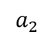
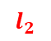
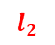
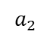
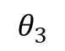
























Mechanics – 4
1
2
$$a_{1}$$
$$a_{2}$$
W(0)
3
$$l_{2}$$
$$l_{1}$$
$$θ_{2}$$
$$θ_{1}$$
T(4)
1
2
$$a_{1}$$
$$a_{2}$$
$$a_{3}$$
W(0)
3
1
$$l_{2}$$
2
$$l_{1}$$
$$θ_{2}$$
$$θ_{3}$$
$$a_{2}$$
$$l_{3}$$
W(0)
$$a_{1}$$
$$a_{3}$$
$$θ_{1}$$
$$θ_{4}$$
$$a_{4}$$
$$l_{2}$$
3
$$l_{4}$$
$$l_{1}$$
$$θ_{2}$$
$$θ_{3}$$
$$l_{3}$$
T(4)
$$θ_{1}$$
T(4)
$$θ_{2}:0°\sim 75°$$
$$θ_{3}:0°\sim 85°$$
$$θ_{4}:0°\sim 90°$$
1
2
$$a_{1}$$
$$a_{2}$$
$$a_{3}$$
W(0)
3
$$l_{2}$$
$$l_{1}$$
$$θ_{2}$$
$$θ_{3}$$
$$l_{3}$$
$$θ_{1}$$
$$θ_{4}$$
$$a_{4}$$
$$l_{4}$$

Slide 12



















Required Tension
$$θ_{α}=θ_{1}+θ_{2} \\ θ_{β}=θ_{1}+θ_{2}+θ_{3} \\ θ_{γ}=θ_{1}+θ_{2}+θ_{3}+θ_{4}$$
Thread length from W to T
$$l=l_{1}+l_{2}+l_{3}+l_{4}$$
$$=\sqrt{{\left(a_{1}−l_{1}\right)}^{2}+a_{2}^{2}+2\left(a_{1}−l_{1}\right)a_{2}C_{2}}+\sqrt{{\left(a_{3}−l_{3}\right)}^{2}+a_{4}^{2}+2\left(a_{3}−l_{3}\right)a_{4}C_{4}}$$
1
2
$$a_{1}$$
$$a_{2}$$
$$a_{3}$$
W(0)
3
$$l_{2}$$
$$l_{1}$$
$$θ_{2}$$
$$θ_{3}$$
$$l_{3}$$
$$θ_{1}$$
$$θ_{4}$$
$$a_{4}$$
$$T$$
$$l_{4}$$
T(4)
$$θ_{a}$$
1
$$T=T_{a}+T_{b},$$
$$T^{′}=T_{a}^{′}+T_{b}^{′}$$
$$T_{a}^{′}=T_{a}\sin{θ_{a}}$$
$$T_{b}^{′}=T_{b}\sin{θ_{b}}$$
$$θ_{a}=\sin^{−1}{\frac{\left(a_{1}−l_{1}\right)\sin{θ_{2}}}{l_{2}}}$$
$$θ_{b}=\sin^{−1}{\frac{\left(a_{3}−l_{3}\right)\sin{θ_{4}}}{l_{4}}}$$
2
$$θ_{b}$$
0
$$T_{a}$$
3
$$T_{a}^{′}$$
$$T_{b}$$
$$T$$
4
$$T_{b}^{′}$$

Slide 13










Required Tension
$$T=T_{a}+T_{b}$$
$$T_{a}^{′}=T_{a}\sin{θ_{a}}$$
$$T_{b}^{′}=T_{b}\sin{θ_{b}}$$
$$θ_{a}=\sin^{−1}{\frac{\left(a_{1}−l_{1}\right)\sin{θ_{2}}}{l_{2}}}$$
$$θ_{b}=\sin^{−1}{\frac{\left(a_{3}−l_{3}\right)\sin{θ_{4}}}{l_{4}}}$$
$$θ_{a}$$
1
2
$$θ_{b}$$
0
$$T_{a}$$
3
$$T_{a}^{′}$$
$$T_{b}$$
$$T$$
4
$$T_{b}^{′}$$
$$T^{′}=T_{a}^{′}+T_{b}^{′}$$
$$θ_{c}$$
$$mg=4T^{′}\cos^{2}{θ_{c}}$$
$$T^{′}$$
$$4T^{′}$$
source: iStock
$$mg$$

Slide 14









Mechanics
$$a_{1}=85mm \\ a_{2}=25mm \\ l_{1}=65mm \\ θ_{1}=0° \\ θ_{2}=0°\sim 75°$$
1
2
$$a_{1}$$
$$a_{2}$$
W(0)
3
$$l_{1}$$
$$θ_{2}$$
$$l_{2}$$
$$θ_{1}=0$$
T(4)
$$l=l_{1}+l_{2} \\ =l_{1}+\sqrt{{\left(a_{1}−l_{1}\right)}^{2}+a_{2}^{2}+2\left(a_{1}−l_{1}\right)a_{2}C_{2}}$$
$θ_{2}=0°$ : ${l=a}_{1}+a_{2}=110mm$
$θ_{2}=75°$ : $l=100.83mm$

Slide 15








Mechanics
$$a_{1}=85mm \\ a_{2}=25mm \\ a_{3}=25mm \\ l_{1}=a_{1} \\ l_{2}=20mm \\ θ_{3}=0°\sim 85°$$
1
2
$$a_{1}$$
$$a_{2}$$
$$a_{3}$$
W(0)
3
$$l_{1}$$
$$l_{2}$$
$$l_{3}$$
$$θ_{3}$$
T(4)
$$l=l_{1}+l_{2}+l_{3} \\ =l_{1}+l_{2}+\sqrt{{\left(a_{2}−l_{2}\right)}^{2}+a_{3}^{2}+2\left(a_{2}−l_{2}\right)a_{3}C_{3}}$$
$θ_{3}=0°$ : ${l=a}_{1}+a_{2}+a_{3}=135mm$
$θ_{3}=85°$ : $l=130.92mm$

Slide 16






Mechanics
$$a_{1}=85mm \\ a_{2}=25mm \\ a_{3}=25mm \\ a_{4}=25mm \\ l_{1}=a_{1} \\ l_{2}=a_{2} \\ l_{3}=20mm \\ θ_{2}=0°\sim 90°$$
1
2
$$a_{1}$$
$$a_{2}$$
$$a_{3}$$
W(0)
3
$$l_{1}$$
$$l_{2}$$
$$l_{3}$$
$$θ_{4}$$
$$a_{4}$$
$$l_{4}$$
T(4)
$$l=l_{1}+l_{2}+l_{3}+l_{4}=l_{1}+l_{2}+l_{3}+\sqrt{{\left(a_{3}−l_{3}\right)}^{2}+a_{4}^{2}+2\left(a_{3}−l_{3}\right)a_{4}C_{4}}$$
$θ_{4}=0°$ : ${l=a}_{1}+a_{2}+a_{3}+a_{4}=160mm$
$θ_{4}=90°$ : $l=155.50mm$

Slide 17




